Slide 2
Award Presentation Collaborative Initiative for Paediatric HIV Education and Research (CIPHER) Grant and Fellowship Programmes
Anton Pozniak, United Kingdom
Share your thoughts on this presentation with #IAS2019

Slide 3
CIPHER Grant Programme
Objectives
Development of early-stage investigators
Address research gaps in paediatric and adolescent HIV
Resource-limited settings
Grants
80% funds awarded to applicants from LMICs
Up to US$ 150,000 for two years
http://www.iasociety.org/cipher

Slide 4
2019 CIPHER Grantee Ceri Evans Zvitambo Institute for Maternal and Child Health Research, Zimbabwe
The impact of improved water, sanitation and hygiene (WASH) on cytomegalovirus co-infection in HIV-affected mothers and children in rural Zimbabwe

Slide 5
2019 CIPHER Grantee Tongdiyen Jasper Institute of Human Virology, Nigeria
The impact of structured caregiver peer support (CaPS) on ART adherence and viral suppression among children living with HIV in Nigeria: A randomized controlled trial

Slide 6
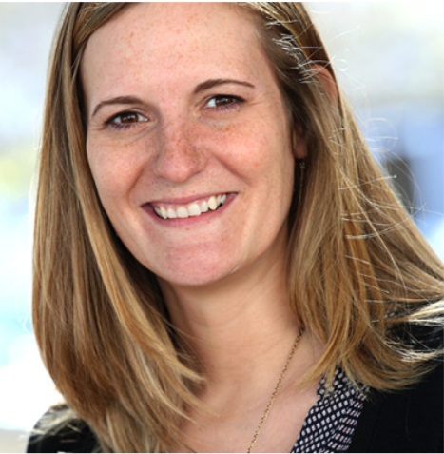
2019 CIPHER Grantee Sarah Skeen Stellenbosch University, South Africa
Khwezi Lokusa (Early Morning Star) Project: Integrating an evidence-based intervention component to promote HIV testing of young children into community-based parenting programmes

Slide 7
CIPHER is pleased to launch a new round of the Grant Programme
Are you a young investigator working on paediatric and adolescent HIV?
Apply to the CIPHER Grant Programme and become the principal investigator on a sizeable grant for the first time while addressing critical research gaps
This year, we also welcome applications in French
Applications open 1 October 2019
http://www.iasociety.org/cipher

Slide 8
CIPHER Growing the Leaders of Tomorrow Fellowship Programme
Objectives
Strengthen paediatric and adolescent HIV clinical research capacity in sub-Saharan Africa
Mentored fellowship for junior investigators
Fellowship
Up to US$ 70,000 for two years
http://www.iasociety.org/cipher

Slide 9
2019 CIPHER Fellow Janan Dietrich Wits Health Consortium, University of the Witwatersrand, South Africa mentored by Catherine Matthews
An investigation of factors associated with viral suppression among adolescent girls and young women living with HIV and participating in the HERStory Study in six South African districts.

